Slide 1
Business Pitching
Module 12

Slide 2
Techno Datelines (subject to disruption)
Week | Topics
1, 2 5.3, 7.3 12.3, 14.3 | M1 (module 1): Overview: Technopreneurship “The Big Picture” The Global Entrepreneurial Revolution for a Flatter World M2: Introduction to Business Model Canvas (BMC) Introduction to an integrated suite of Business Model tools – EM, BMC & VPC (VPD Canvas) Milestone 1: Form Business Start-up Groups (minimum 3, maximum 4 members)
3 19.3, 21.3 | QUIZ 1 M3: Patterns: Long Tail, Multi-sided Platform, Free, Open M4: Design: Customer Insights, Ideation, Prototyping, Scenarios, M5: Strategy: Environment, Blue Ocean Strategy Milestone 2 : Business Start-up Proposal/Idea with current BMC and initial BMC & VPC. Submission & Approval
4 26.3, 28.3 | M6: Value Proposition Design Canvas (VPC): Customer Profile, Value Map, Fit M7: Design: Prototyping Possibilities, Starting Points,
5 2.4, 4.4 | QUIZ 2 M7 : Understanding Customers, Making Choices, Finding the Right Business Model, Designing in Established organizations Milestone 3: First Draft Business Case Proposal with EM, new BMC and VPC Prototype(s) Due (with proper citations/ references and evidences
Break 6.4-4.4 | Semester Break Eid Mubarak
6 16.4, 18.4 | M8: Case Study: Taxi M9: Test, What to Test, Testing Step-by-Step, Experiment Library, Bringing it All Together Evolve: Create Alignment, Measure & Monitor, improve Relentlessly, Reinvent Yourself Constantly
Week | Topics
7 23.4, 25.4 | M10-11 : The Business Plan Entrepreneurial Leader and the Team The Harvest and Beyond Milestone 4: Start Customer Discovery & Validation via Value Proposition Design Canvas/Prototypes Fit
8 30.4, 2.5 | 30.4 NO CLASS 2.5 ONLINE QUIZ Milestone 6: Updated Business Case Paper Due following journal/article format– with revised/ validated BMC and VPC (with proper citations/ references and evidences) – hardcopy & softcopy
9 7.5, 9.5 | M10-11 : Resource Requirements, Bootstrapping & Entrepreneurial Finance, Business Plan Cash-flow, P&L
10 14.5, 16.5 | Case Study on Business Plan and Financing modelling Case study on current and future disruptive business models. M12: Introduction to BP Pitching
11, 12,13 21.5, 23.5 28.5, 30.5 4.6, 6.6 | Project Presentation & Business Pitching
14 11.6, 13.6 | M13: Latest developments on Technopreneurship Milestone 7: Revised Business Plan (BP) Due with Enhanced Business Case Paper in the BP appendix (hard and softcopy).

Slide 3
What is it?
More broadly put, a pitch is a presentation of a business idea to potential investors. People pitch a business because they need resources.
If the goal is to raise startup cash, the target of the pitch is an investor.
Other businesses pitch to potential customers to sell their product.

Slide 4
What should a business pitch include?
Your business pitch might include the following:
Industry analysis.
Customer needs.
Marketing strategy.
Business model.
BOS
Exit strategy
Overview of the competition.
Risks.
Implementation plan.
Financial projection.

Slide 5
What is the purpose of pitching?
The purpose of a pitch is to QUICKLY get the potential investor's attention, let them know what you have and what you are offering to get them to say… “Tell me more!!”
Parts of The 90 Second Elevator Pitch: It is important to note each pitch differs based upon the context of the idea being presented.

Slide 6
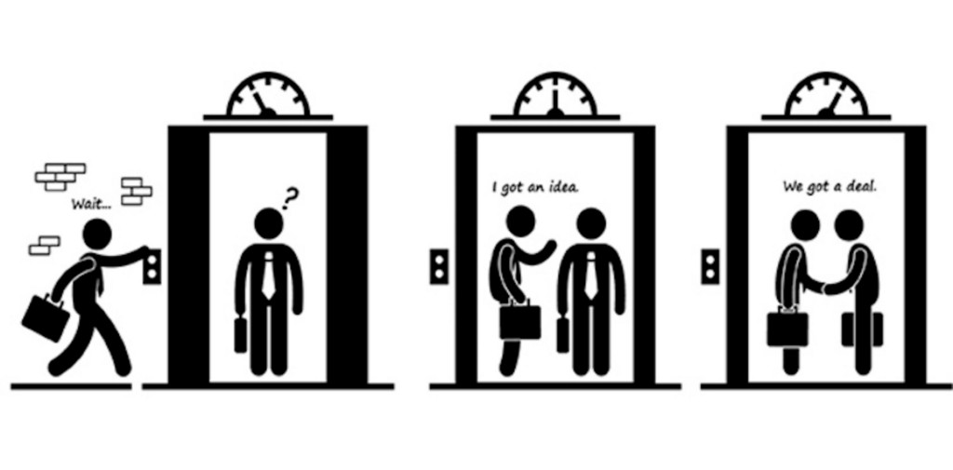
The elevator pitch

Slide 7
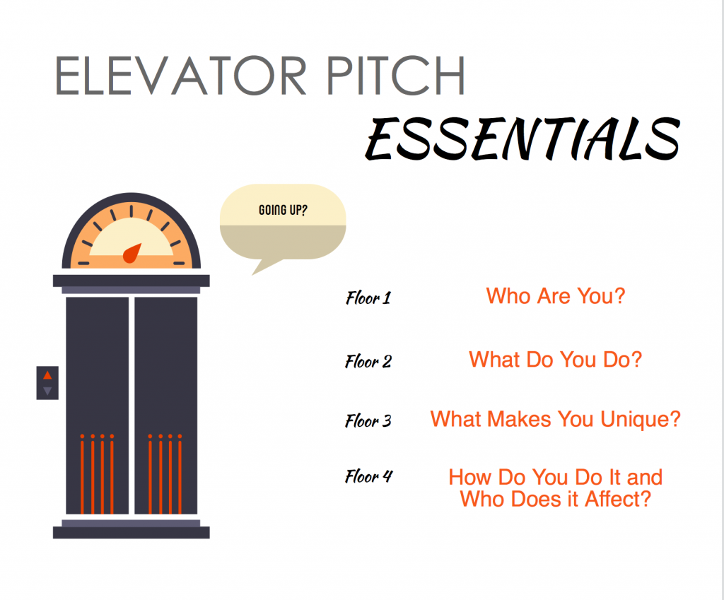

Slide 8
How do you start a business pitch?
Take only ten minutes. ...
Turn your pitch into a story. ...
Be laser-focused. ...
Explain exactly what your product or service is. ...
Explain exactly what is unique about your product or service. ...
Explain exactly who your target audience is. ...
Explain exactly how you intend to acquire these customers. ...
Explain your business revenue model.

Slide 9
How do you end a pitch?
Closing a Sales Presentation
Go back to your opening anecdote or idea.
End with a challenge.
Invite your audience on a metaphorical mission.
Use repetition for a dramatic close.
Offer inspiration.
Surface their objections.
Tell a story.
Ask an unusual question.

Slide 10
Example of A Good Pitch
https://www.facebook.com/watch/?v=812185226055742

